Slide 1
Chapter 7
Steady-State Errors

Slide 2
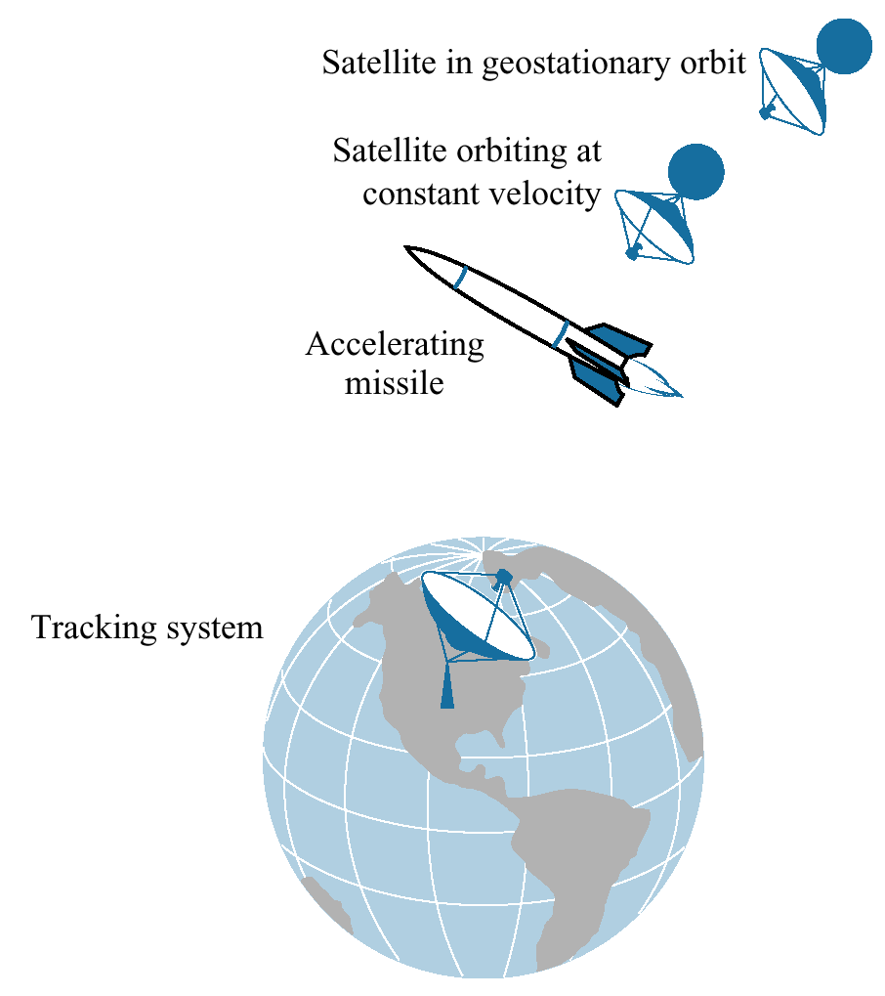
Figure 7.1
Test inputs for steady-
state error analysis
and design vary with
target type

Slide 3
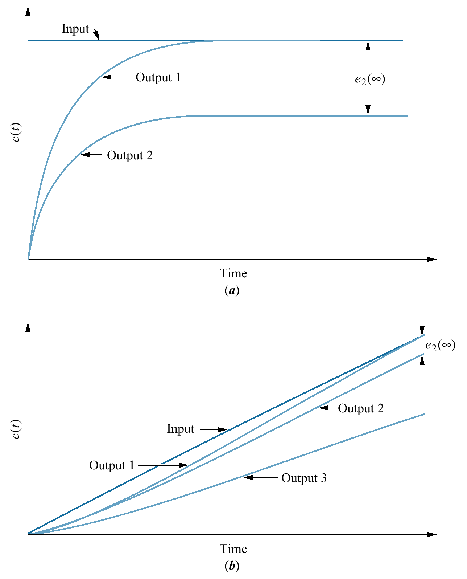
Figure 7.2
Steady-state error:
a. step input;
b. ramp input

Slide 4
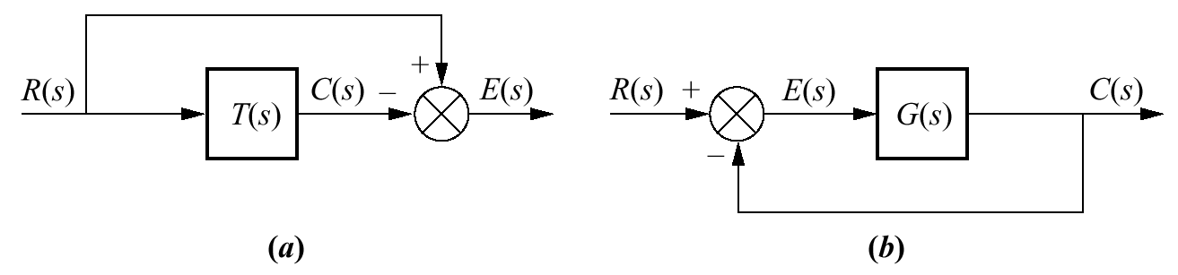
Figure 7.3
Closed-loop control
system error:
a. general representation;
b. representation for
unity feedback
systems

Slide 5
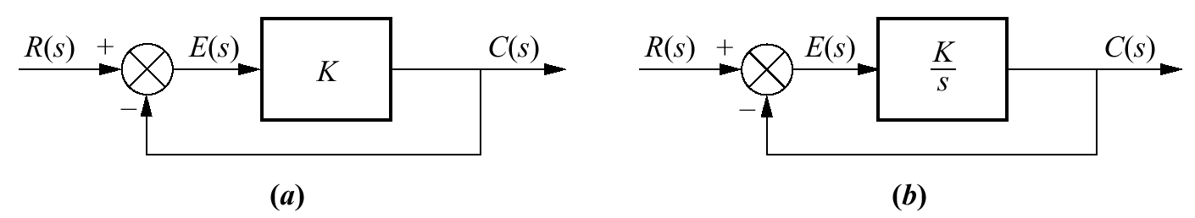
Figure 7.4
System with:
a. finite steady-state
error for a step input;
b. zero steady-state
error for step input

Slide 6
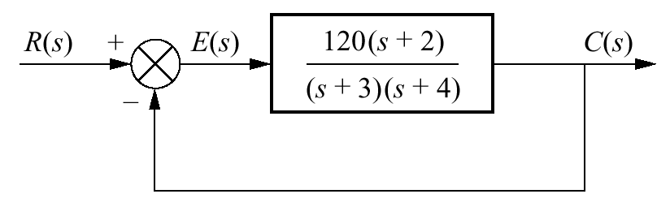
Figure 7.5
Feedback
control system for
Example 7.2

Slide 7
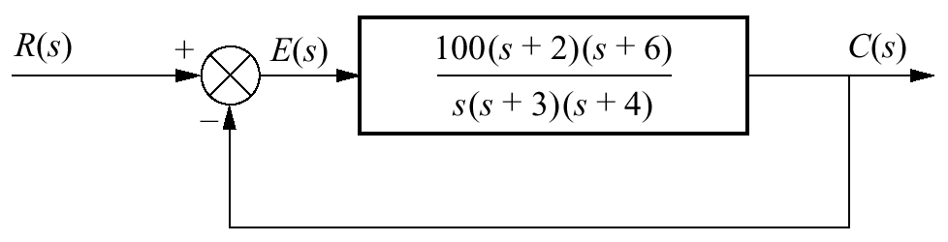
Figure 7.6
Feedback
control system for
Example 7.3

Slide 8
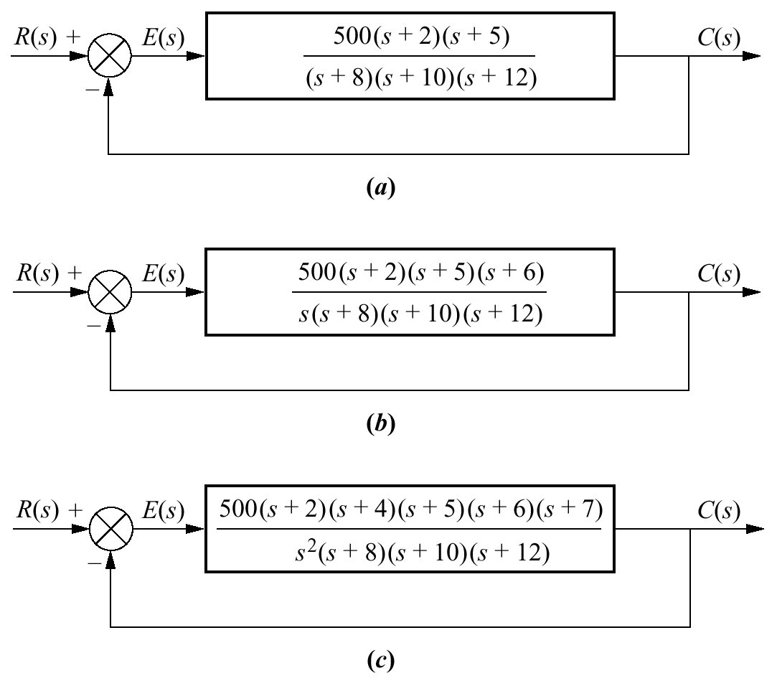
Figure 7.7
Feedback
control systems
for Example 7.4

Slide 9
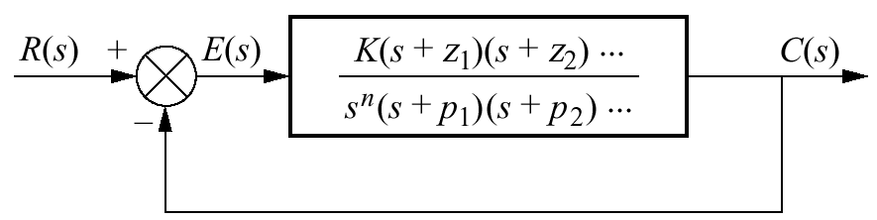
Figure 7.8
Feedback control
system for defining
system type

Slide 10
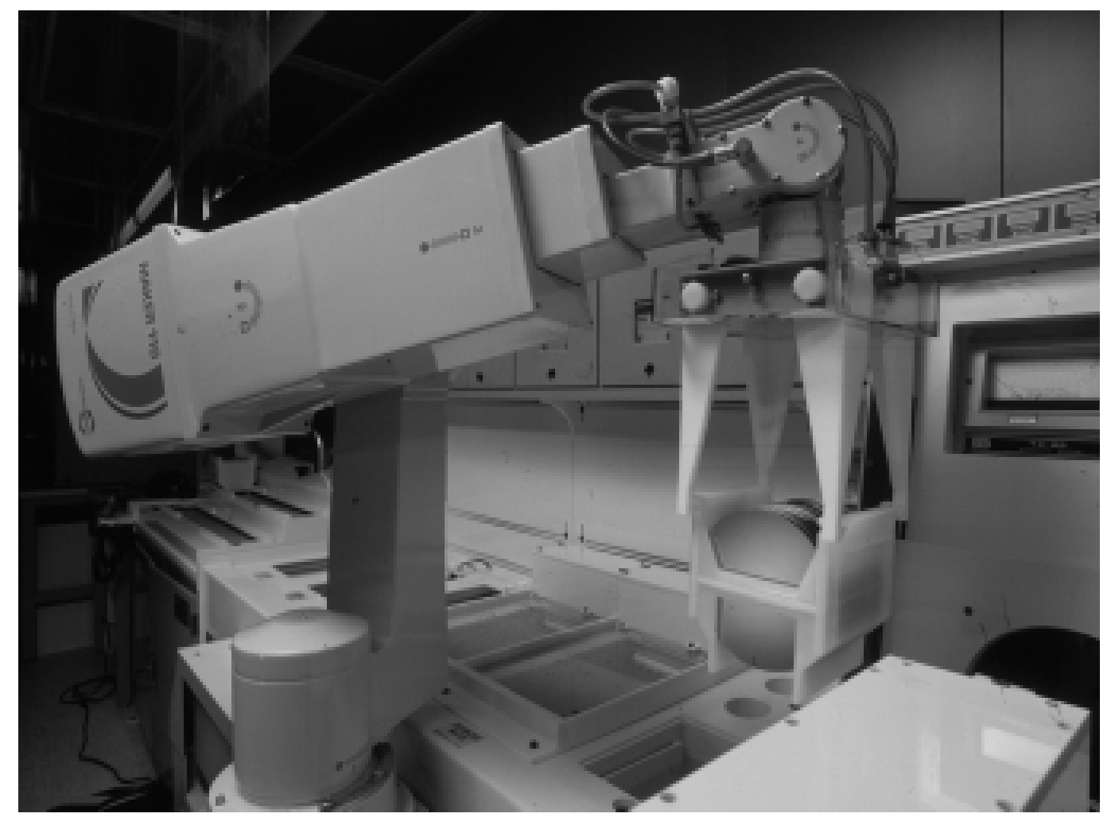
Figure 7.9
A robot used in
the manufacturing
of semiconductor
random-access
memories (RAMs)
similar to those in
personal computers.
Steady-state error is
an important design
consideration for
assembly-line robots.

Slide 11
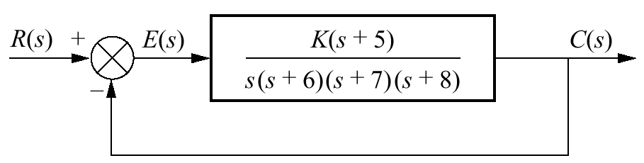
Figure 7.10
Feedback
control system
for Example 7.6

Slide 12
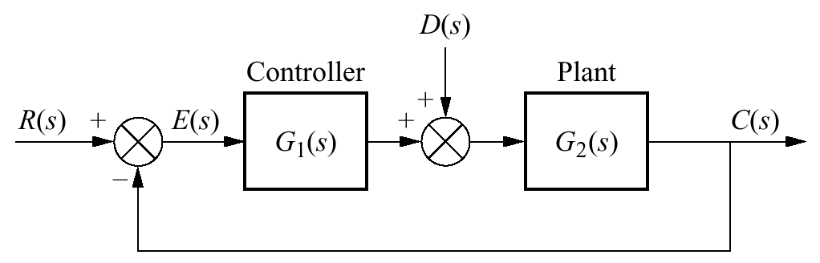
Figure 7.11
Feedback control
system showing
disturbance

Slide 13
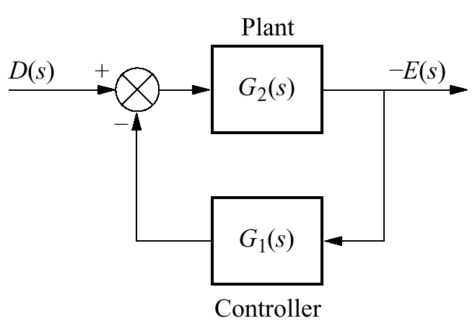
Figure 7.12
Figure 7.11 system
rearranged to show
disturbance as input
and error as output,
with R(s) = 0

Slide 14
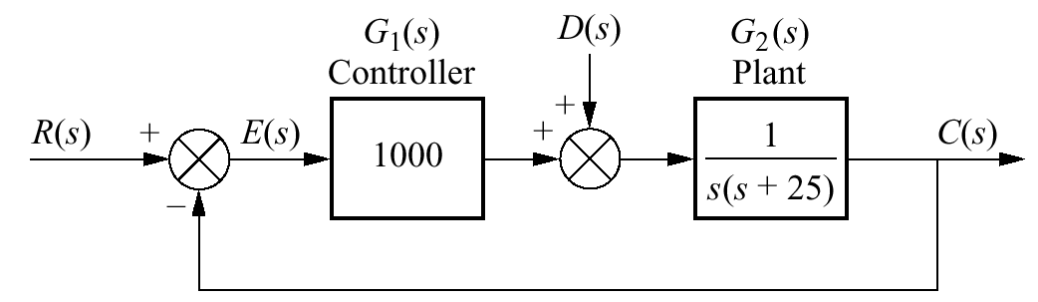
Figure 7.13
Feedback control
system for Example
7.7

Slide 15
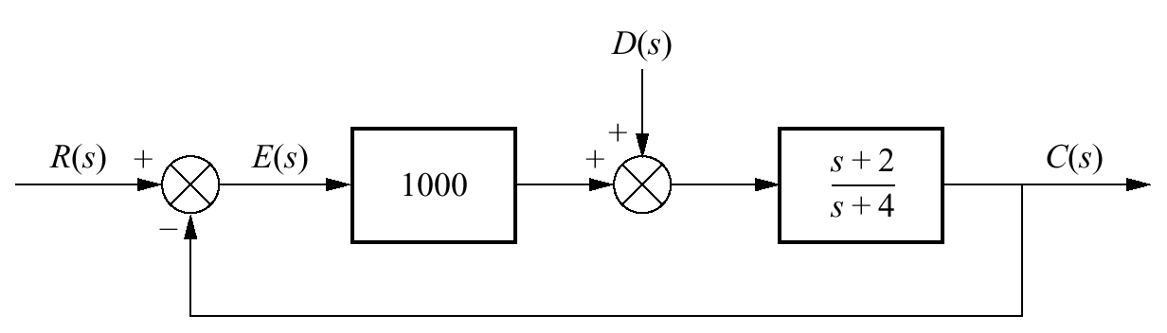
Figure 7.14
System for
Skill-Assessment
Exercise 7.4

Slide 16
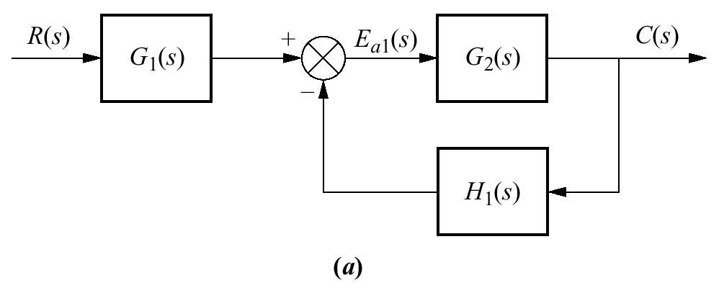
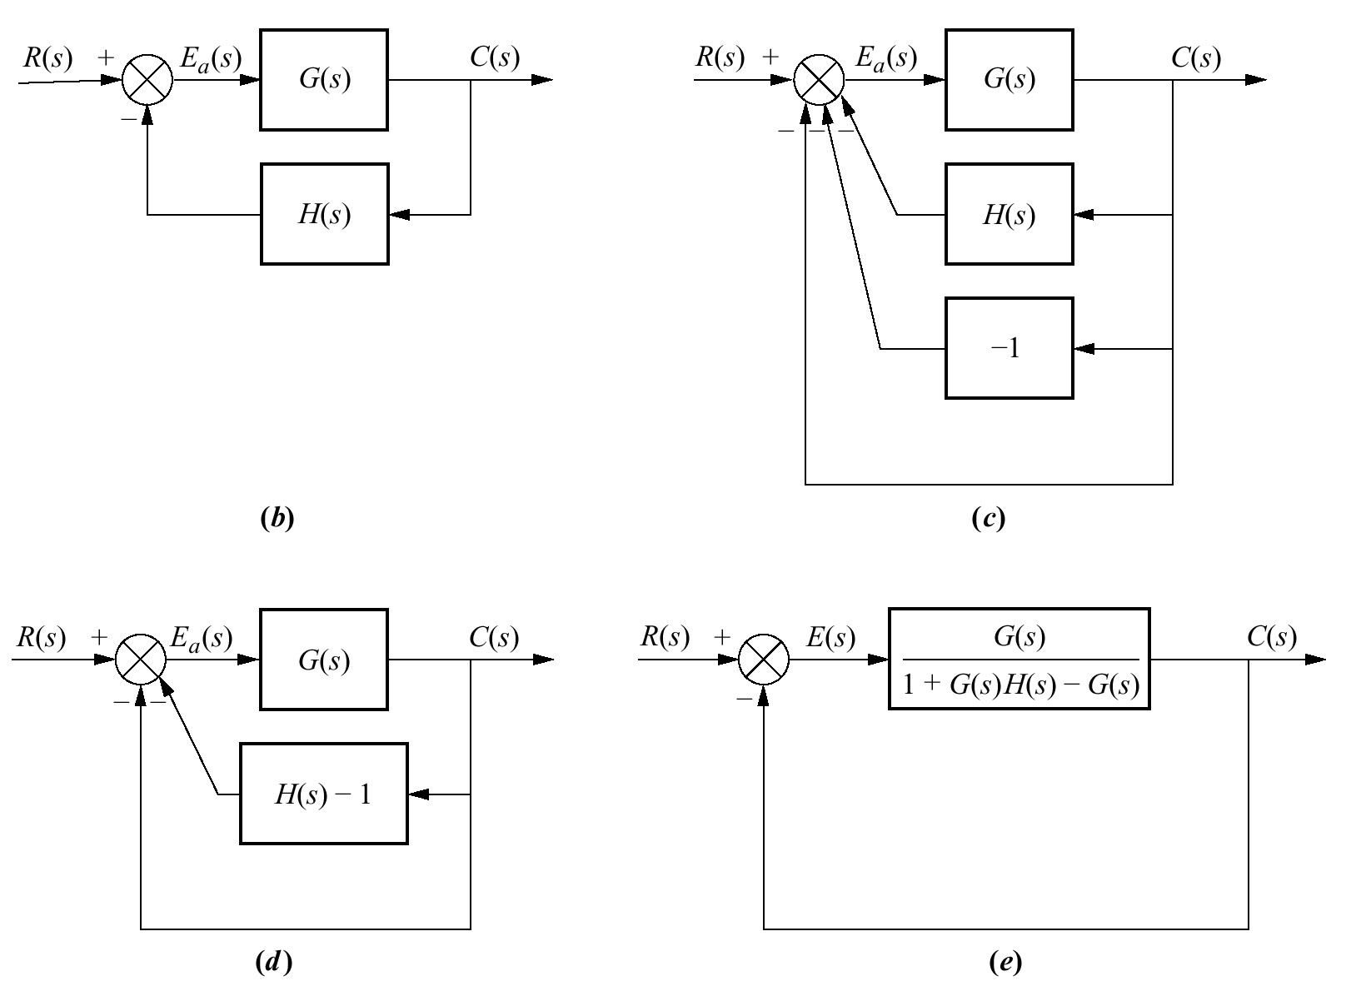
Figure 7.15
Forming an
equivalent
unity feedback
system from a
general nonunity
feedback system

Slide 17
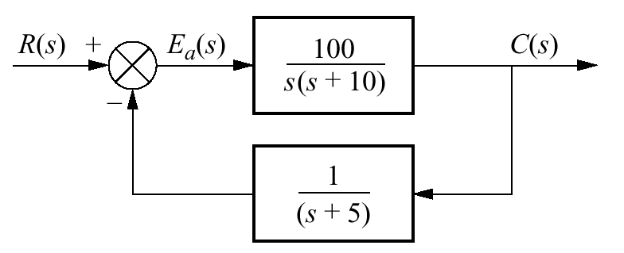
Figure 7.16
Nonunity feedback
control system for
Example 7.8

Slide 18
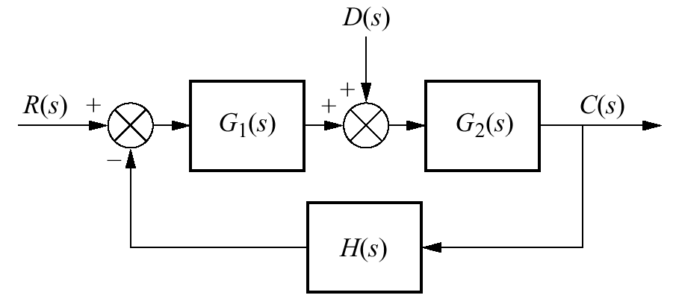
Figure 7.17
Nonunity feedback
control system with
disturbance

Slide 19
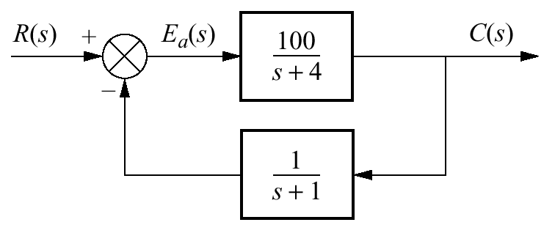
Figure 7.18
Nonunity feedback
system for
Skill-Assessment
Exercise 7.5

Slide 20
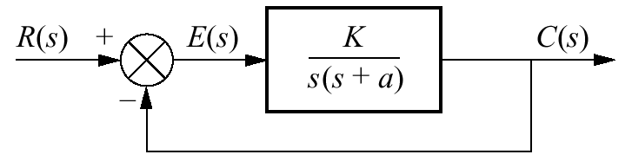
Figure 7.19
Feedback control
system for Examples
7.10 and 7.11

Slide 21
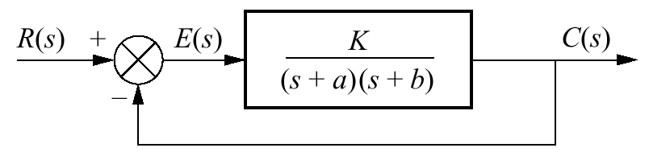
Figure 7.20
Feedback
control system
for Example 7.12

Slide 22
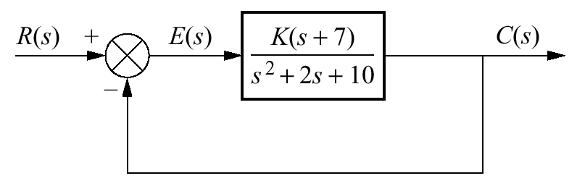
Figure 7.21
System for
Skill-Assessment
Exercise 7.6

Slide 23
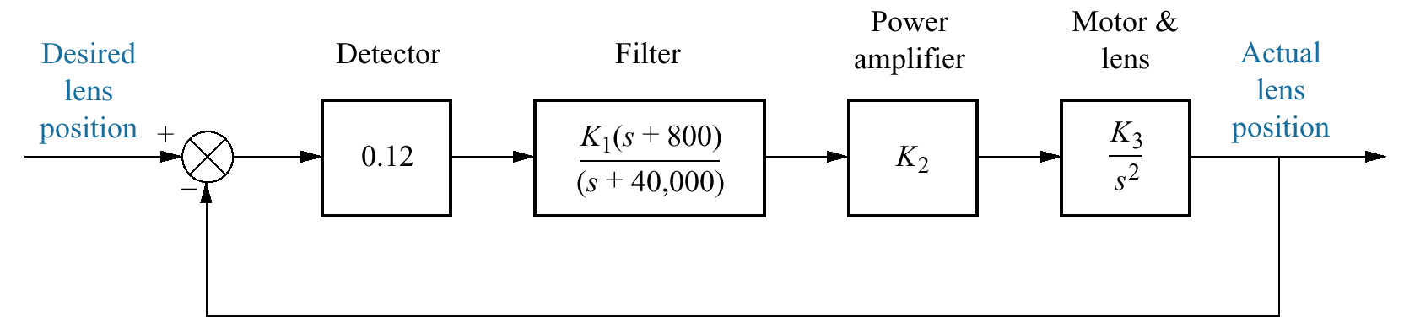
Figure 7.22
Video laser disc
recording:
control system for
focusing write beam

Slide 24
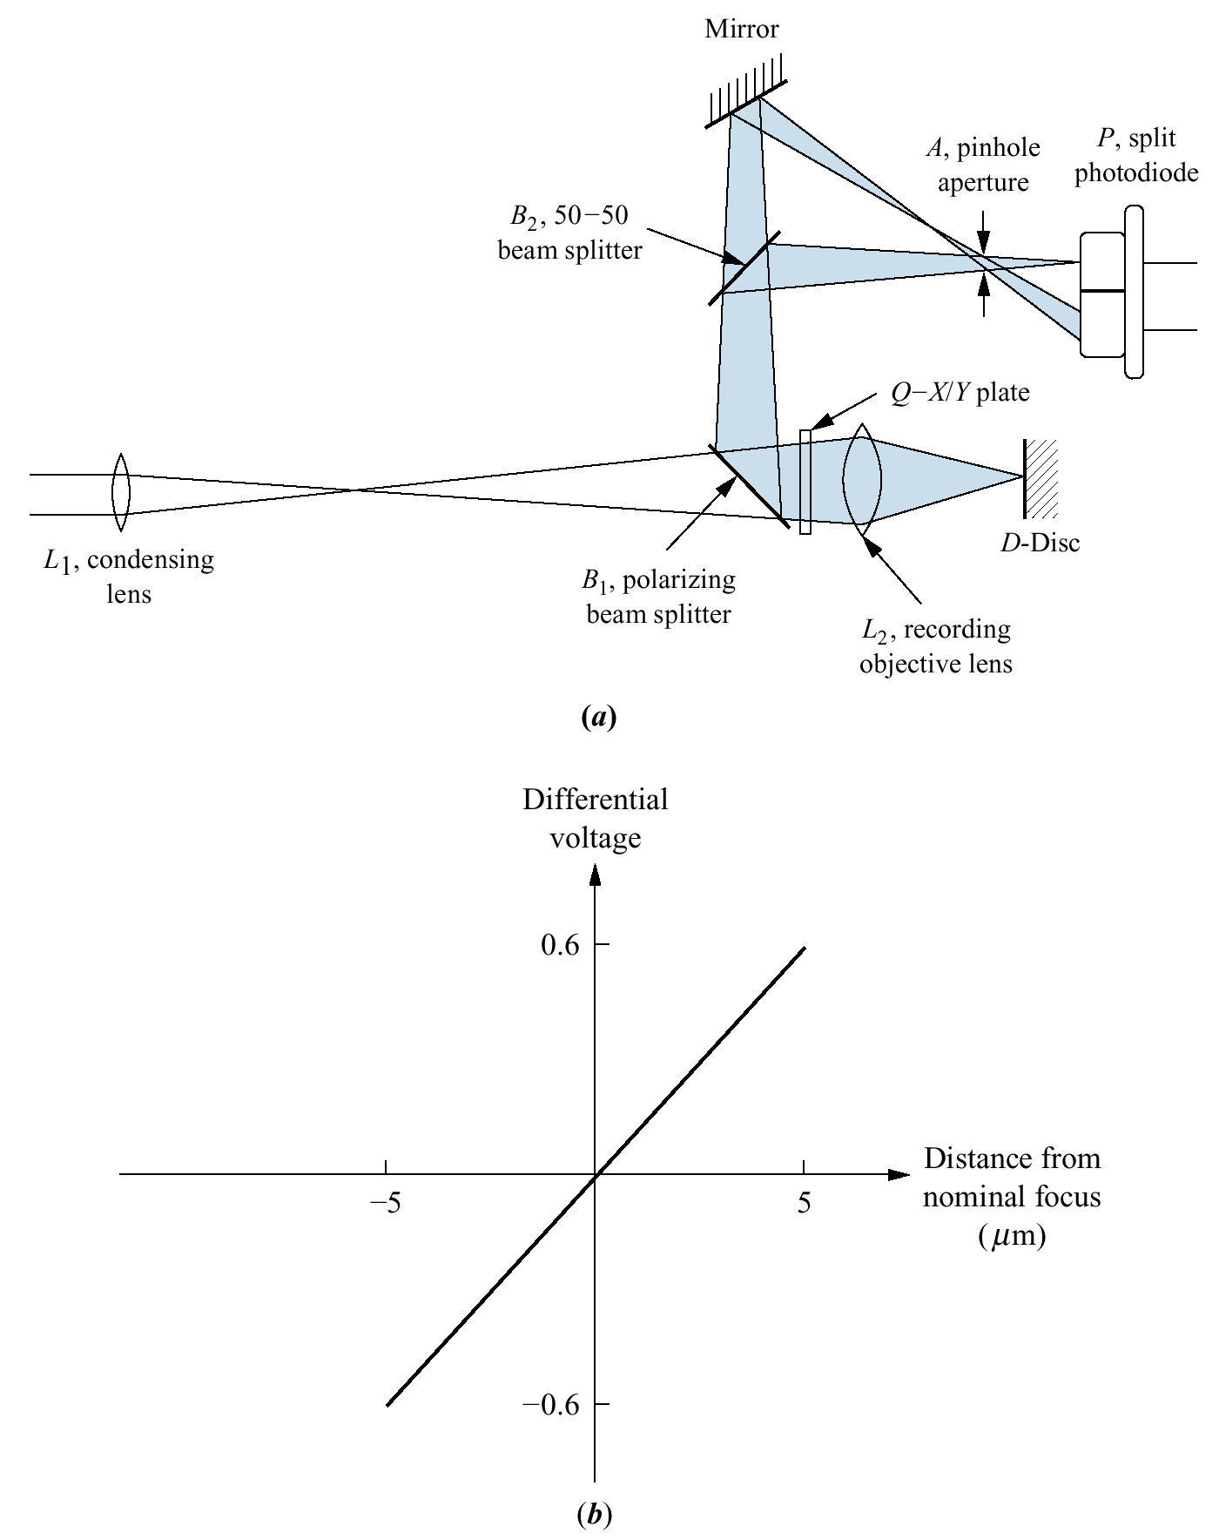
Figure 7.23
Video disc laser
recording:
a. focus detector
optics;
b. linearized transfer
function for focus
detector

Slide 25
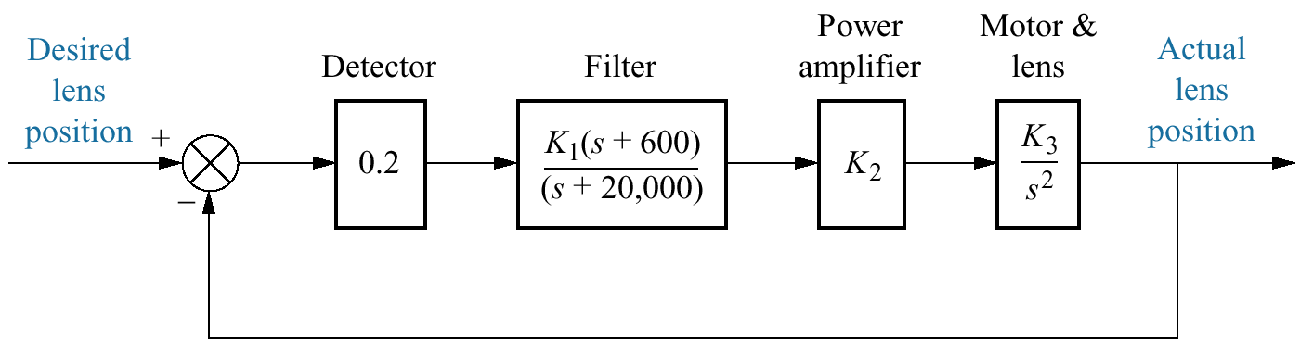
Figure 7.24
Video laser disc
recording focusing
system

Slide 26
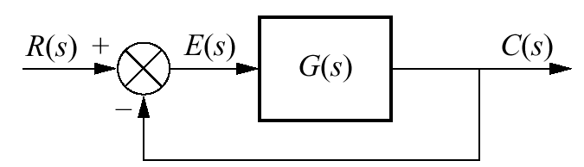
Figure P7.1

Slide 27
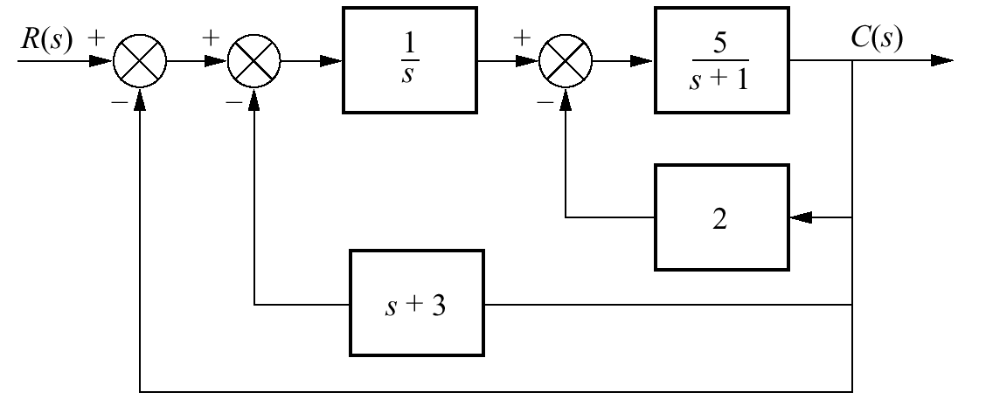
Figure P7.2

Slide 28
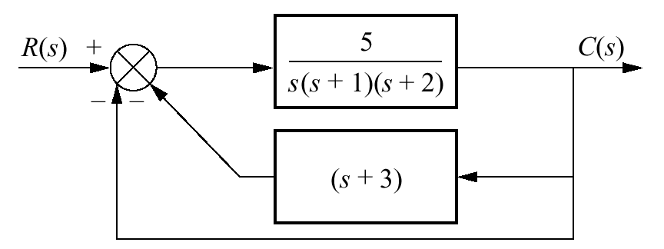
Figure P7.3

Slide 29
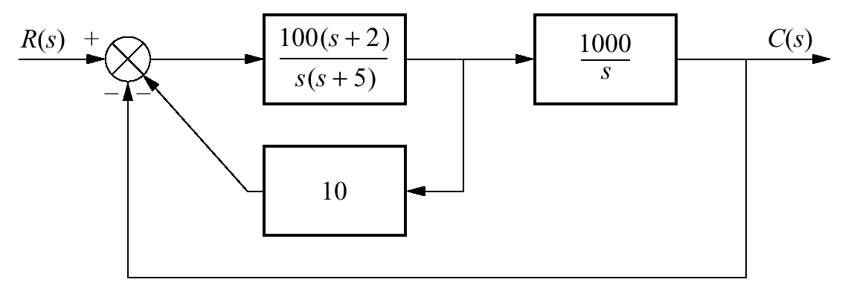
Figure P7.4

Slide 30
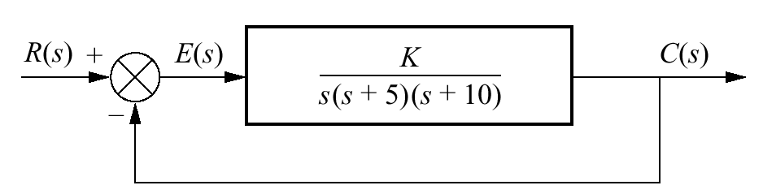
Figure P7.5

Slide 31
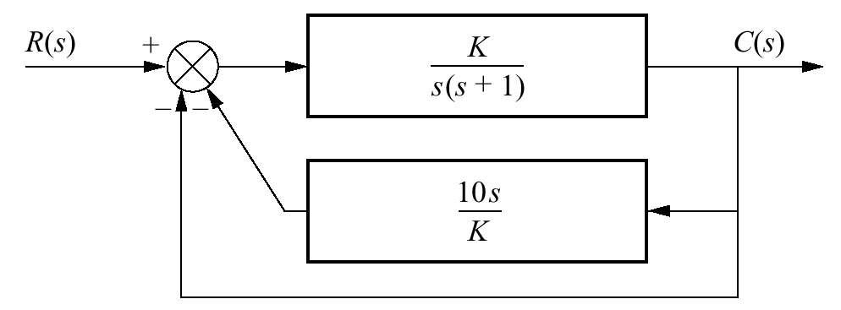
Figure P7.6

Slide 32
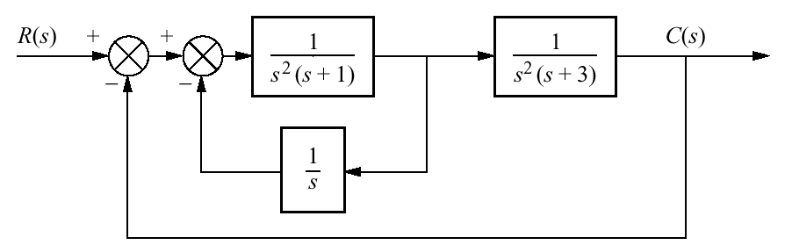
Figure P7.7

Slide 33
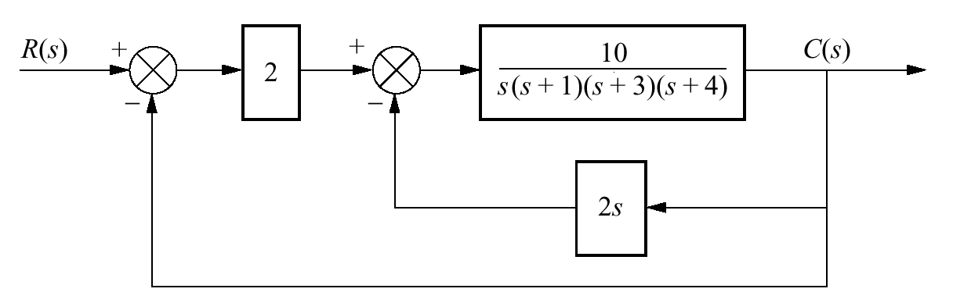
Figure P7.8

Slide 34
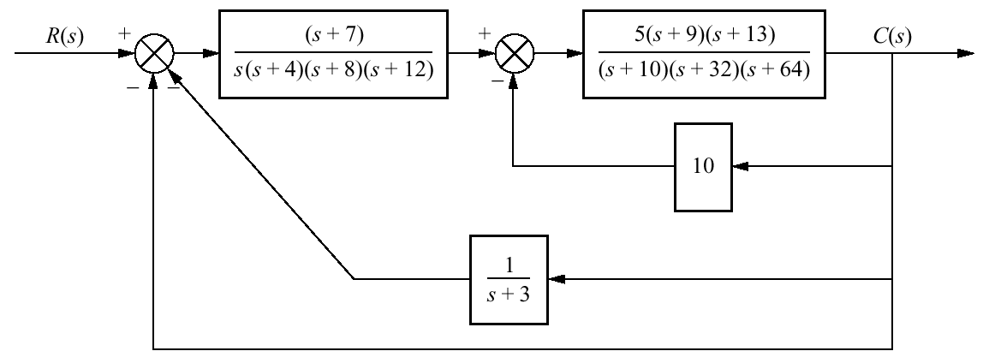
Figure P7.9

Slide 35
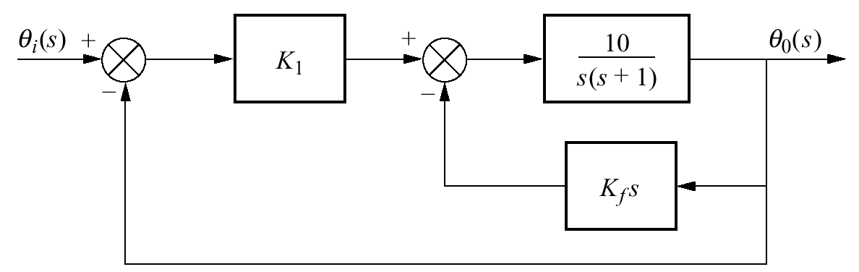
Figure P7.10

Slide 36
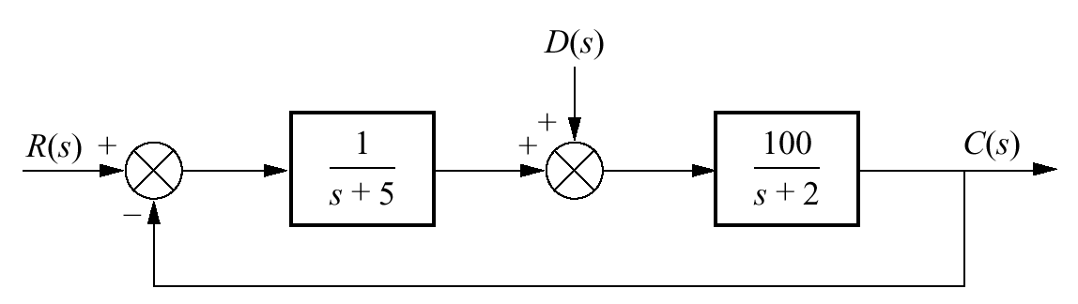
Figure P7.11

Slide 37
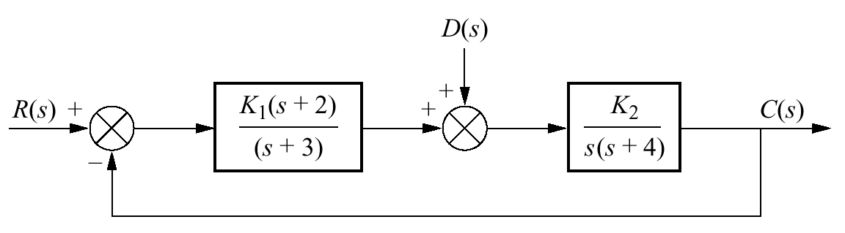
Figure P7.12

Slide 38
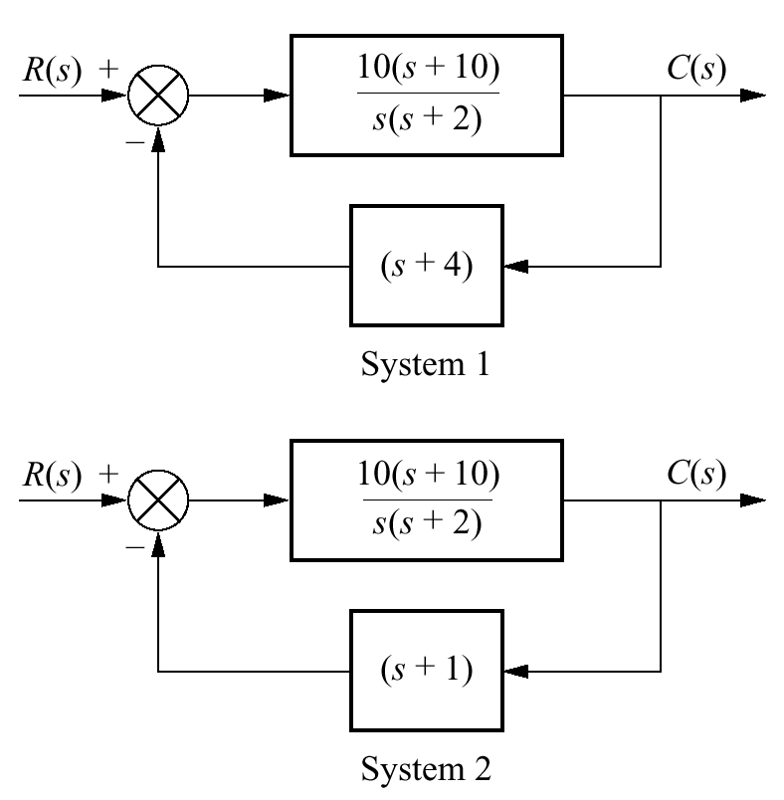
Figure P7.13
Closed-loop
systems with
nonunity
feedback

Slide 39
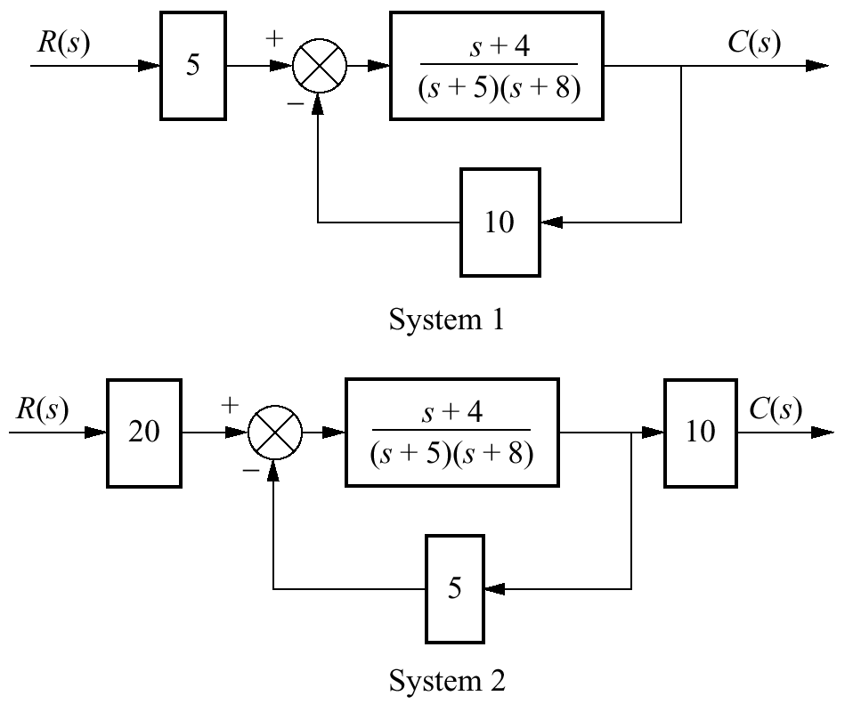
Figure P7.14

Slide 40
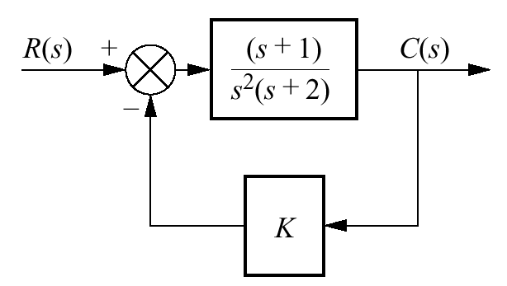
Figure P7.15

Slide 41
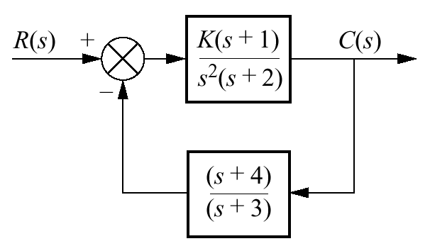
Figure P7.16

Slide 42
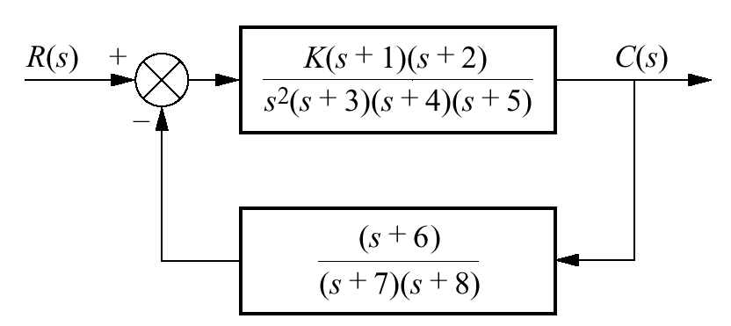
Figure P7.17

Slide 43
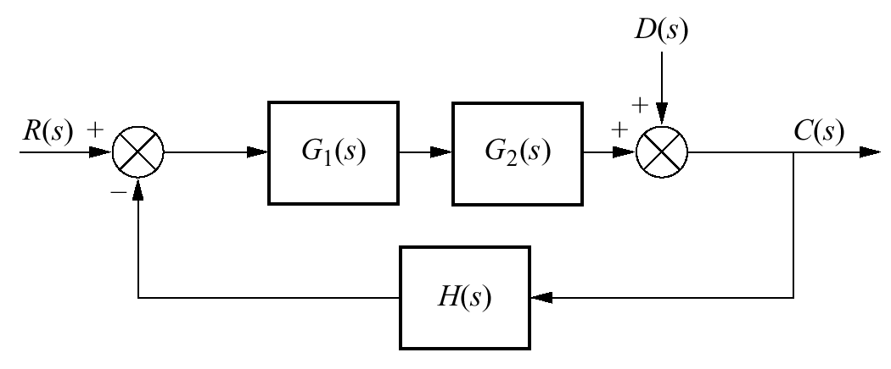
Figure P7.18
System with input and
disturbance

Slide 44
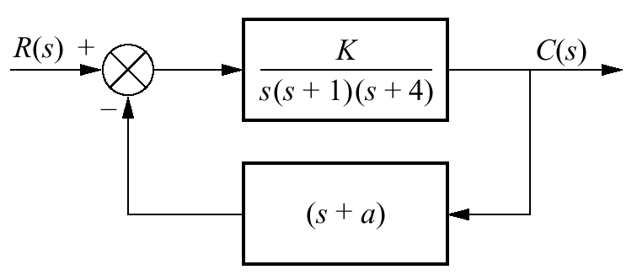
Figure P7.19

Slide 45
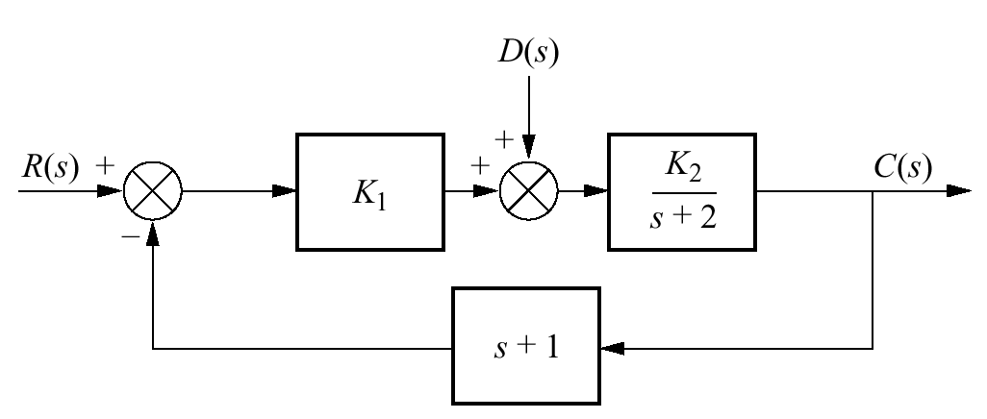
Figure P7.20
System with input and
disturbance

Slide 46
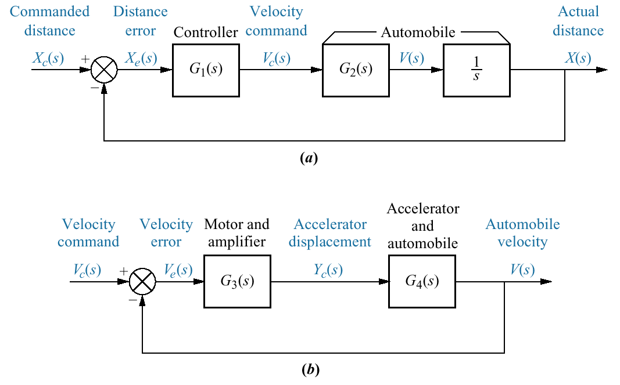
Figure P7.21
Automobile
guidance
system
a. displacement
control system;
b. velocity control
loop

Slide 47
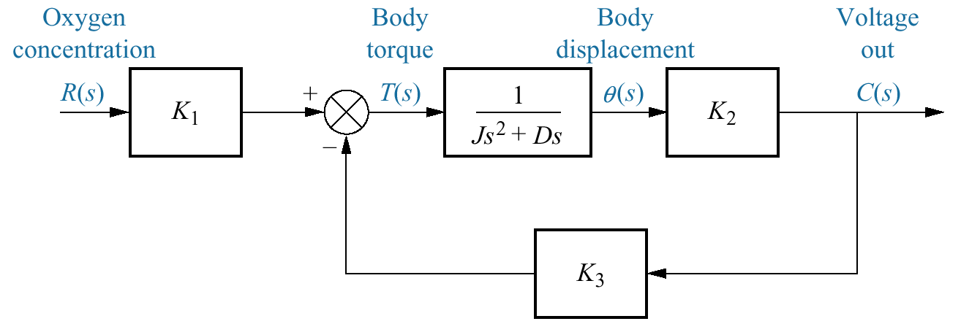
Figure P7.22
Block diagram of a
paramagnetic oxygen
analyzer

Slide 48
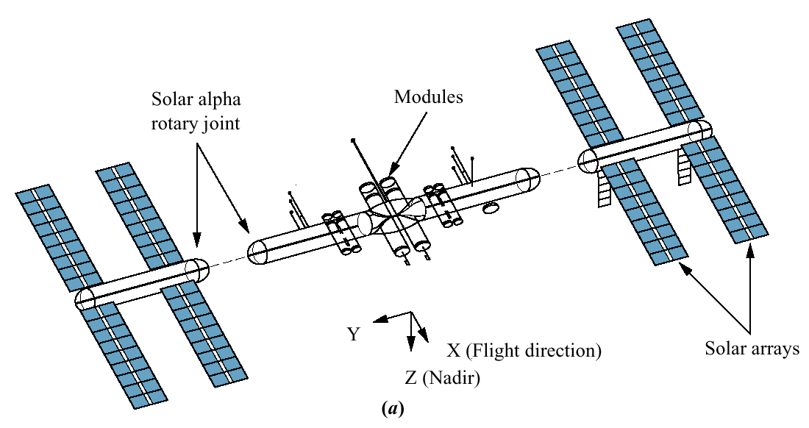
Figure P7.23
Space
station Freedom:
a. configuration
(© 1992 AIAA)
(figure continues)

Slide 49
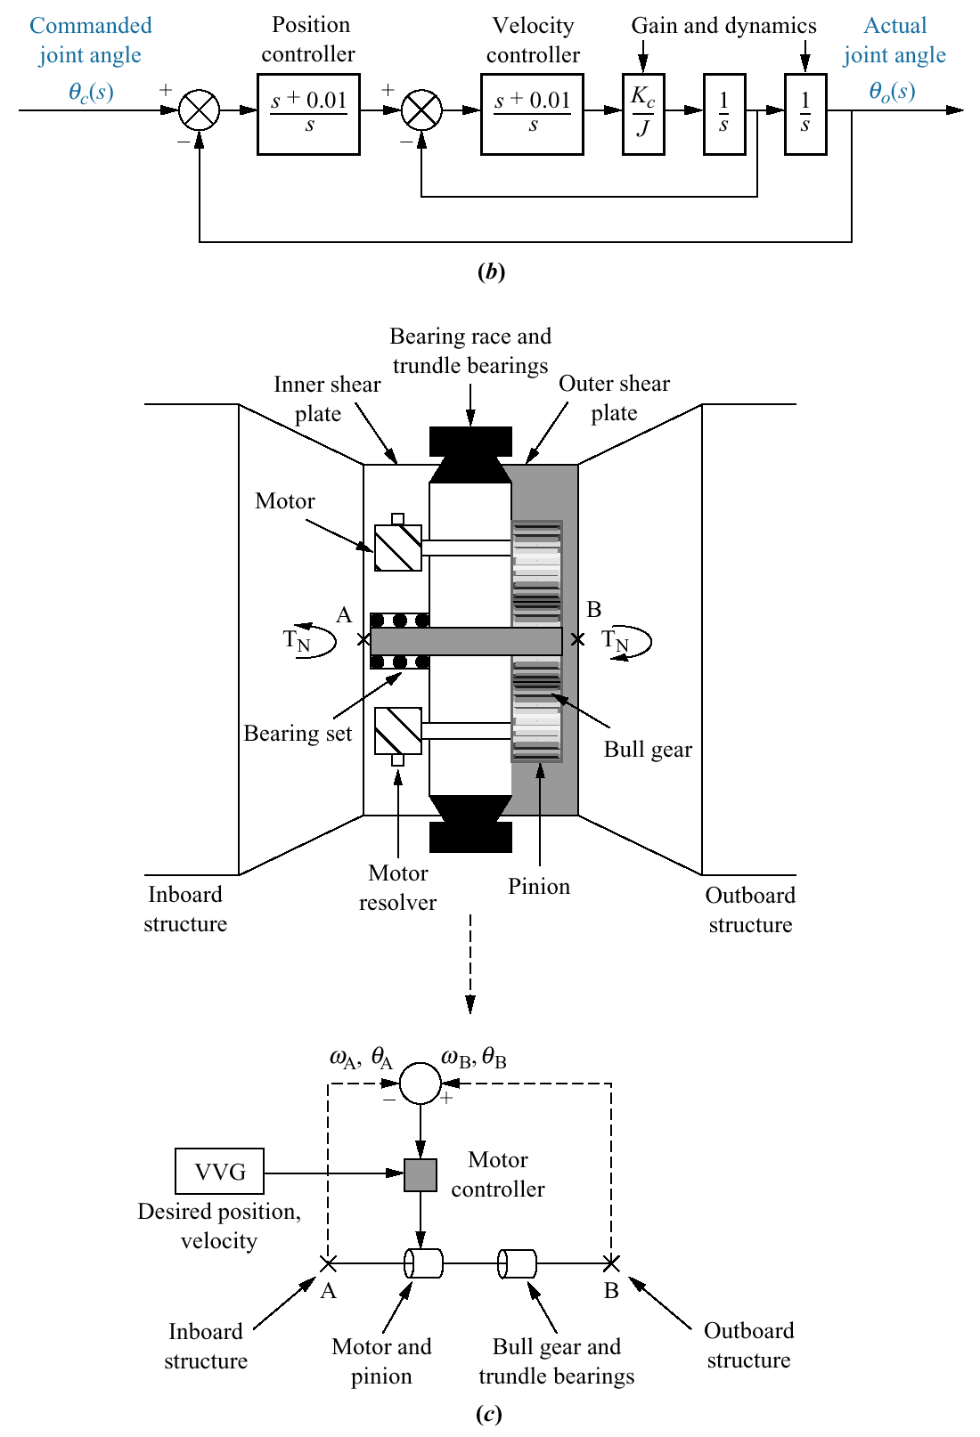
Figure P7.23
(continued)
b. simplified block
diagram
c. alpha joint drive
train and control
system (©1992 AIAA)

Slide 50
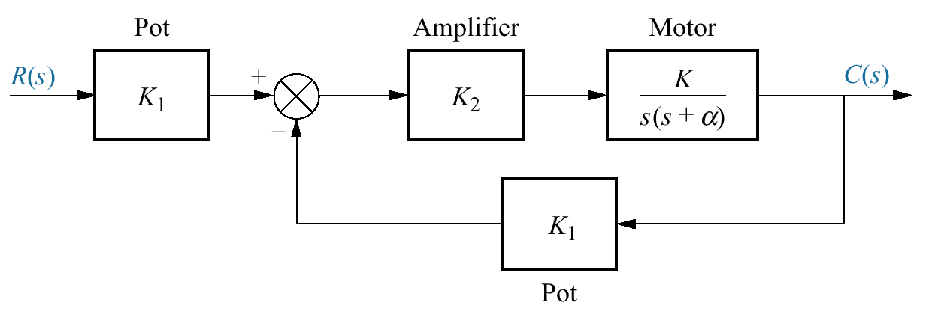
Figure P7.24
Position control
system

Slide 51

Figure P7.25
Boat tracked
by ship’s radar:
a. physical
arrangement;
b. block diagram of
tracking system

Slide 52

Figure P7.26
Simplified block
diagram of a pilot in
a loop (©1992 AIAA)

Slide 53

Figure P7.27
a. Force control
mechanical loop
under contact motion
(©1996 IEEE);
b. block diagram
(©1996 IEEE)

